Slide 1
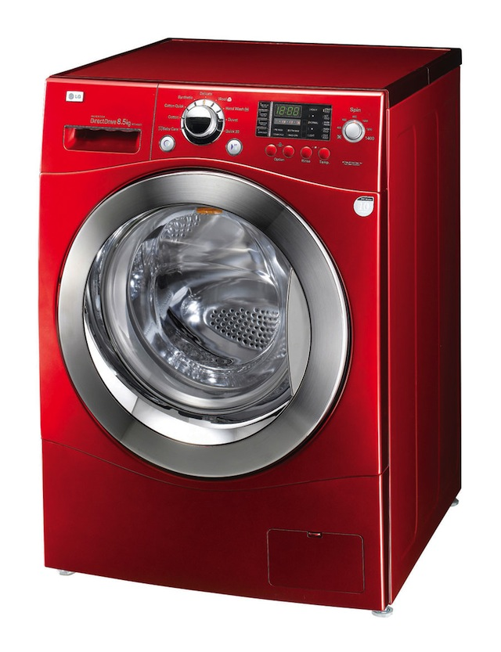
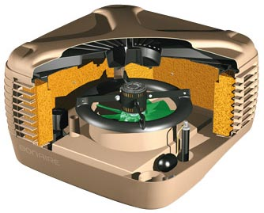

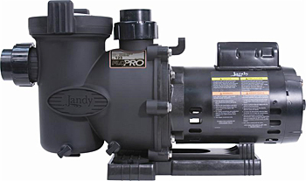
The Interaction of Magnetic Fields The Motor Effect – Part 1

Slide 2

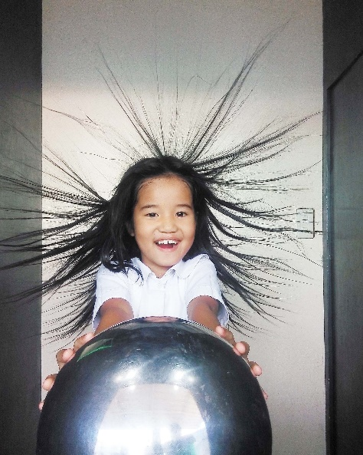
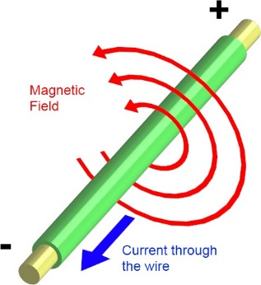
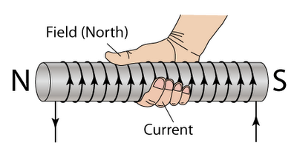
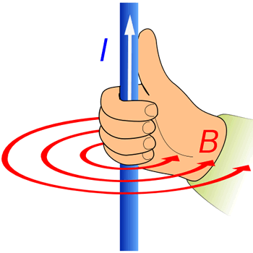
Electric Fields
Forces in Fields
Magnetic Fields
The link between Electric Fields and Magnetism
Physics “Gang Signs” No 1 and 2.

Slide 3

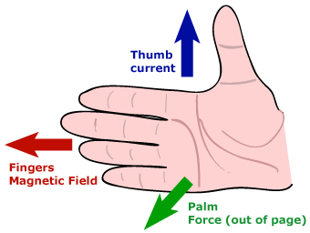
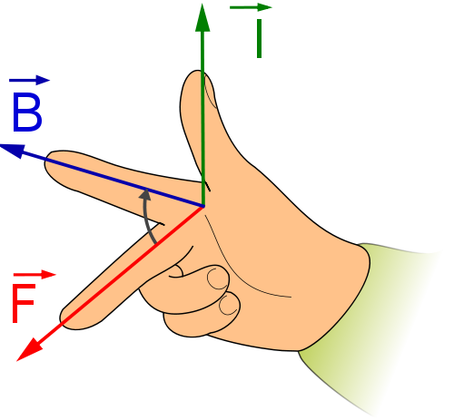
Interaction between current carrying conductors and a magnetic fields.
→ The Motor Effect
Two more Physics Gang Signs
Electric Motors
Motor Effect Calculations – Force and Torque

Slide 4
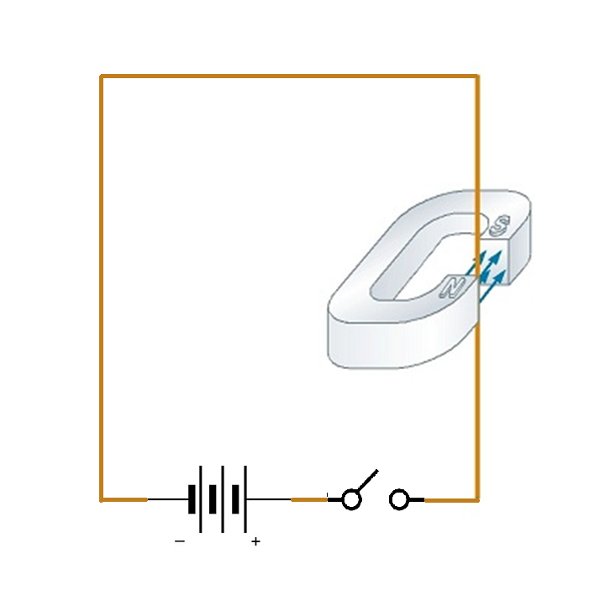
The Motor Effect
INTRO ACTIVITY:
What happens when a current carrying wire is momentarily switched on whilst in a magnetic field?
What happens when the field is reversed?
What happens when the current is reversed?

Slide 5
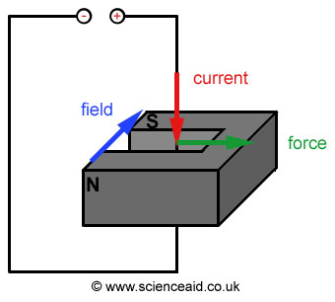
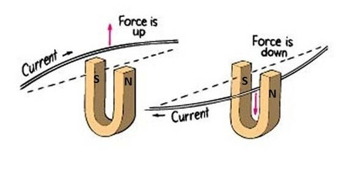
The Motor Effect
When a current is placed in a magnetic field it will experience a force. This is called the motor effect.
The direction of movement is reversed if the magnetic field direction is reversed or the direction of current is reversed.

Slide 6
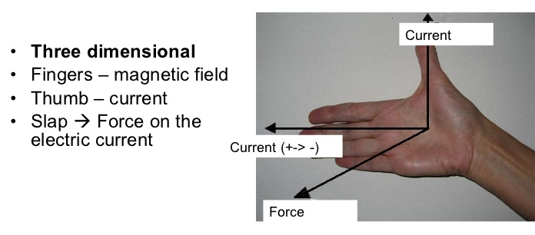
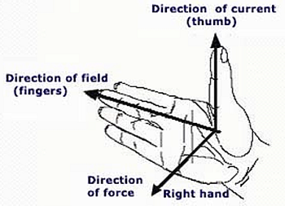
The Motor Effect – A New Gang sign
The direction of the force on a current in a magnetic field is predictable.
It is given by the
right hand “palm / slap rule”
or a variation of Fleming's right hand finger rule.

Slide 7
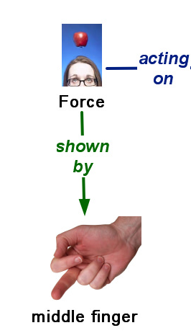
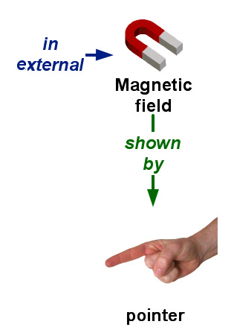
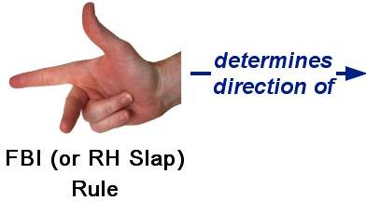
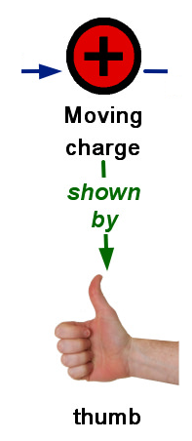
The Motor Effect – A New Gang sign

Slide 8
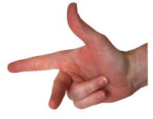
Example - Using the new Physics “Gang Sign”
+
-
S
-
-
+
+
N
-
+

Slide 9
Sample Questions 1-4
Q1. Force direction ?
Q2 Current direction ?
N
S
S
N
Q3 N and S poles ?
Q4 Force directions ?
N
S
N
S
Note:
means current out of the page
means current into the page

Slide 10
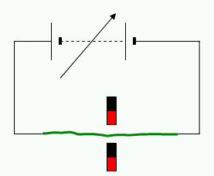
Sample Questions 5
In this example, which way will the wire be pushed?
Current direction is …
left to right.
Field is
down
Therefore FORCE is?
into the page
N
S

Slide 11
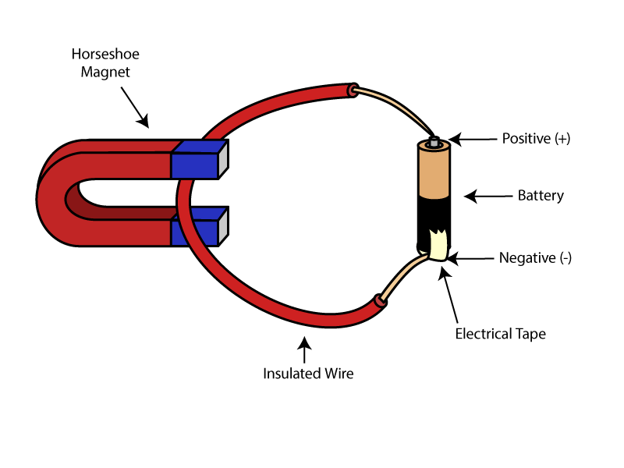
Sample Question 6
Which way will the wire move?
Current direction is …
OUT OF SCREEN.
Field is
down
Therefore FORCE is?
to the right
N

Slide 12
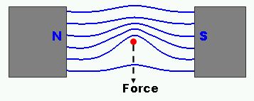
Why does this movement occur?
Consider the fields of the magnet and the wire individually.
Reinforcement occurs here
N
S
Cancellation occurs here
The field is NOT balanced.
Natural systems tend to adjust to achieve equilibrium, and thus a force results

Slide 13
Defining Magnetic Field B
The size of the force (F) on a wire in a field depends on the size of the field (B), the length of wire in the field (L) and the current in the wire (I)

Slide 14
Defining Magnetic Field B
In other words , F α BIL
Where the three quantities are at right angles to each other. Otherwise components must be used.

Slide 15
Defining Magnetic Field B
Magnetic field strength (B) is measured in Tesla (T).
We define the Tesla as the magnetic field when …
the force on 1 m of wire carrying a current of 1 A is 1 N.

Slide 16
Force on a current in a field
Thus the force on a length L of wire carrying a current I in a magnetic field B is given by
F = BIL sinθ
where θ is the angle between the current and the magnetic field.
F = BIL sinθ
What angle is between the current and the magnetic field in this example?
What is the sin of 90⁰ ?
What does this tell us about the forces created by the motor effect?

Slide 17
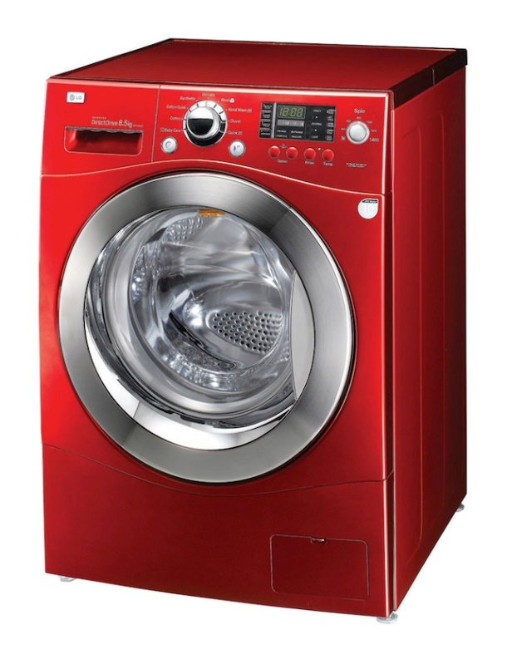

Making Use of the Motor Effect
Countless household items all make use of the Motor Effect.
They all rely on the interaction of a two magnetic fields,
one (or both) of which are produced by the flow of electrical current.

Slide 18
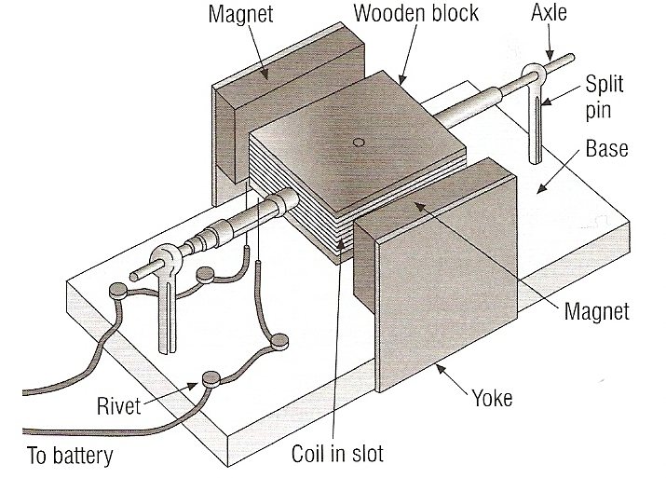
Model Electric Motor
Observe the simplified model of an electric motor you have been shown or provided with.
What design features do you notice?

Slide 19


How does the Electric motor work?
The force on a conductor can be increased by forming a single turn coil
North Pole
Blue spot represents the central pivot point
South Pole

Slide 20

How does the Electric motor work?
The force on a conductor can be increased by forming a single turn coil
Top conductor experiences force to left
North Pole
Force
South Pole

Slide 21

How does the Electric motor work?
The force on a conductor can be increased by forming a single turn coil
Top conductor experiences force to left
North Pole
Force
Force
Bottom conductor experiences force to right
South Pole

Slide 22
How does the Electric motor work?
The force on a conductor can be increased by forming a single turn coil
Top conductor experiences force to left
North Pole
Force
Force
Bottom conductor experiences force to right
South Pole
Combined action causes rotation

Slide 23


How does the Electric motor work?
Forces add up to a rotational force called Torque (T) in Newtons per metre
North Pole
T
T
South Pole

Slide 24
How does the Electric motor work?
rotation axis
N
S
contact brush
Brushes lose contact with the split ring commutator.
Current no longer flows through the motor coil.
The coil will continue to rotate clockwise due to its momentum.
Brushes in contact with the split ring commutator.
Current flows through the motor coil.
Forces exert a clockwise turning effect on the coil
Brushes regain contact with the split ring commutator.
Current flows through the motor coil but in the opposite direction.
Forces exert a clockwise turning effect on the coil.
Brushes lose contact with the split ring commutator.
Current no longer flows through the motor coil.
The coil will continue to rotate clockwise due to its momentum.
Brushes regain contact with the split ring commutator.
Current flows through the motor coil but in the original direction.
Forces exert a clockwise turning effect on the coil.
split-ring commutator
+

Slide 25
D.C.Motor Fields Schematic

Slide 26
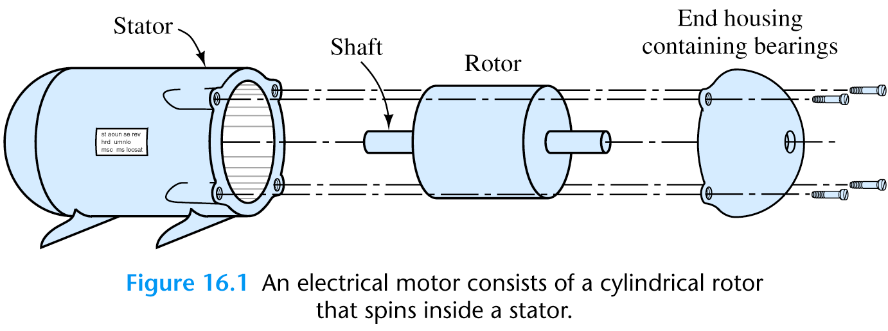
Basics of a Electric Motor

Slide 27
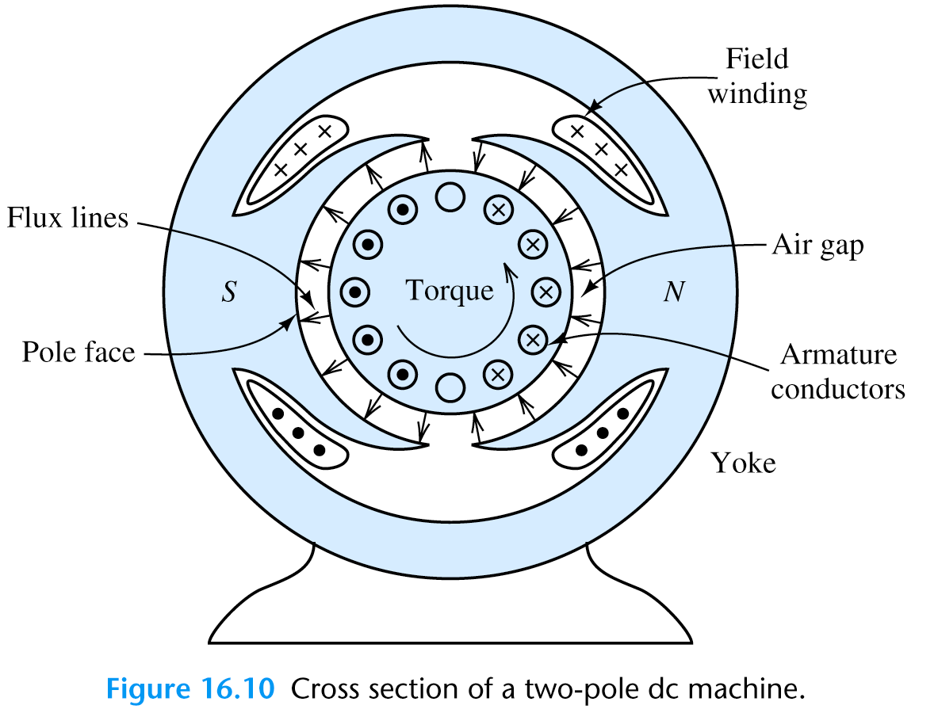
A Two Pole DC Motor

Slide 28
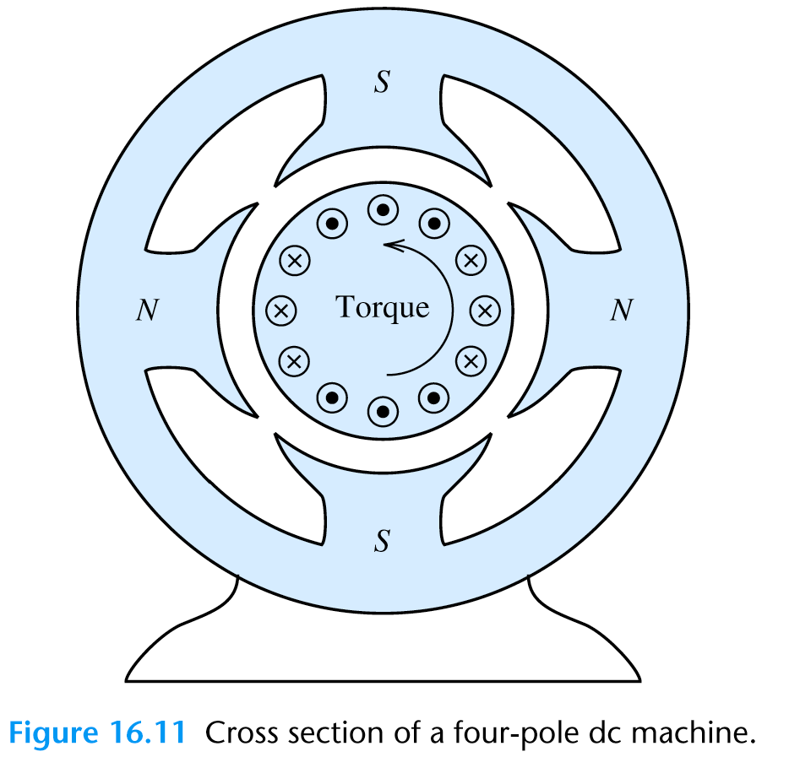
A Four Pole DC Motor

Slide 29
Calculations with Electric motors
For a multi-turn coil
North Pole
Torque produced
T = 2 n F r
T
T
n = number of coil turns
F = force on single conductor
r = radius of coil
South Pole

Slide 30
Calculations with Electric motors
Torque produced
T = 2 n F r
For a multi-turn coil
Example
A 100 turn coil has a radius of 0.1m and a length of 0.15m. It is placed at right angles in a magnetic field of flux density 0.08T and carries 12A, calculate the force on each conductor and the total torque produced by the coil.
North Pole
T
T
South Pole

Slide 31
Calculations with Electric motors
Torque produced
T = 2 n F r
For a multi-turn coil
Example
A 100 turn coil has a radius of 0.1m and a length of 0.15m. It is placed at right angles in a magnetic field of flux density 0.08T and carries 12A, calculate the force on each conductor and the total torque produced by the coil.
North Pole
T
T
F = B I L = 0.08 x 12 x 0.15
= 0.144 N
South Pole
T = 2 n F r = 2 x 100 x 0.144 x 0.1
= 2.88 Nm

Slide 32
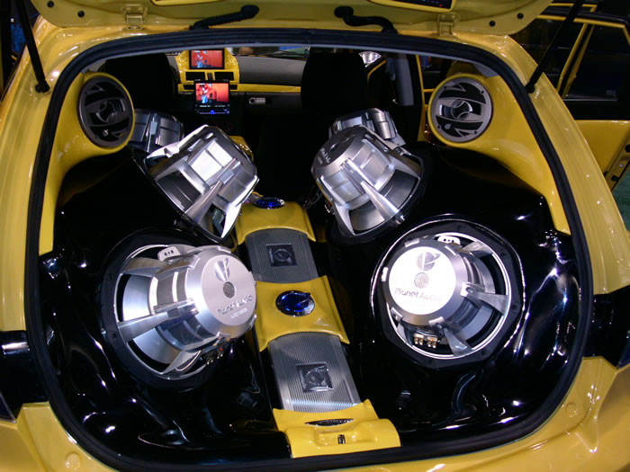
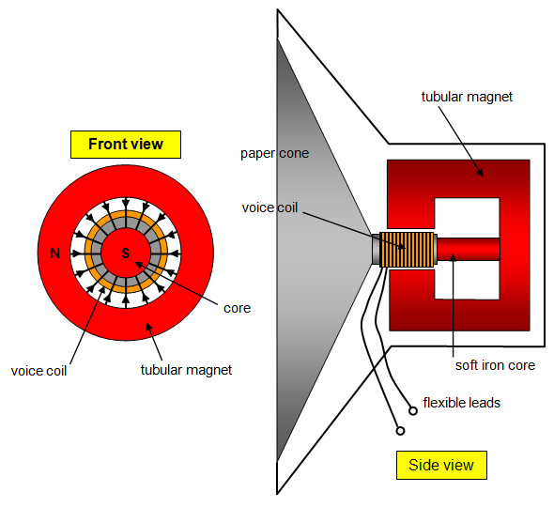
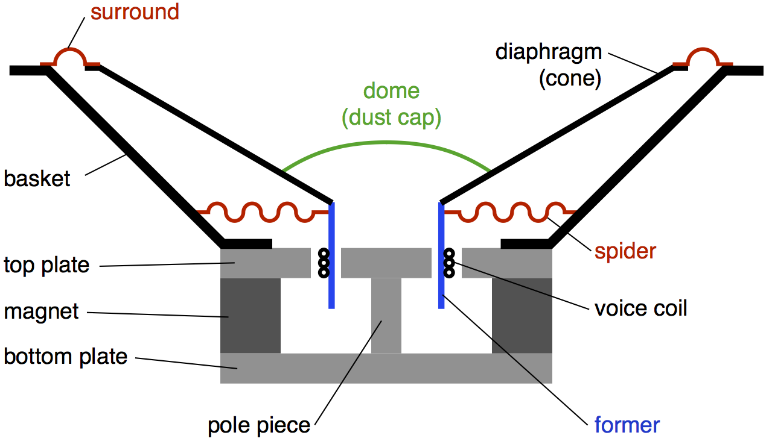
The loudspeaker

Slide 33
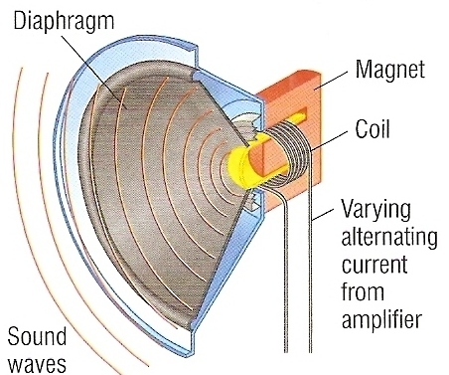
The loudspeaker
The sound signal consists of an alternating current supplied by the amplifier. The frequency of the AC is determined by the sounds that need to be reproduced.
This current flows through the coil of the loudspeaker. It becomes a solenoid.
Due to the motor effect, the magnetic field produced by the coil results in an outward force between it and the permanent magnet over which it sits.

Slide 34
The loudspeaker
Because the alternating current changes direction, so does the direction of the force causing the coil to vibrate in step with the alternating current.
The vibrating coil moves the diaphragm (speaker cone) to which causes air to vibrate and so produces a sound wave.
Different sound frequencies require different rates of direction change in the current.

Slide 35
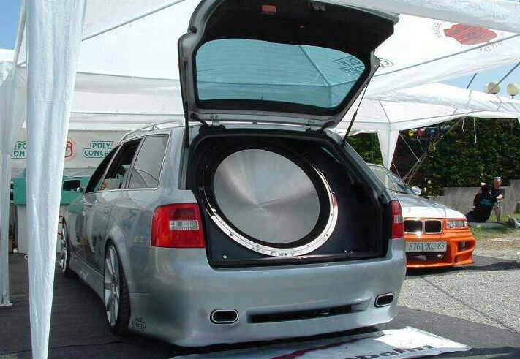

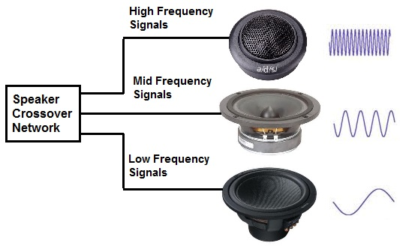
The loudspeaker
Speakers for higher frequencies are smaller than those for low frequencies.
This is because they need to change direction more often and lower masses would mean less inertia to overcome.

